Slide 1
Resources for Sustaining Your School Garden Program

Slide 2
Funding Opportunities
Utah Ag in the Classroom School Garden Center
Senate Bill 458 currently being considered to fund school garden programs in Title 1 schools over the next two years.

Slide 3
Supply Opportunities
Bonnie Plants, Silver Springs
Plant donations to schools when possible. Contact Andrew Clinkenbeard at silverspringsnv@bonnieplants.com or (541) 379-3214.
3rd Grade Cabbage program
Arianna Guison, Donnor Springs Elementary in Reno was the 2018 Nevada Winner of a $1,000 scholarship.

Slide 4
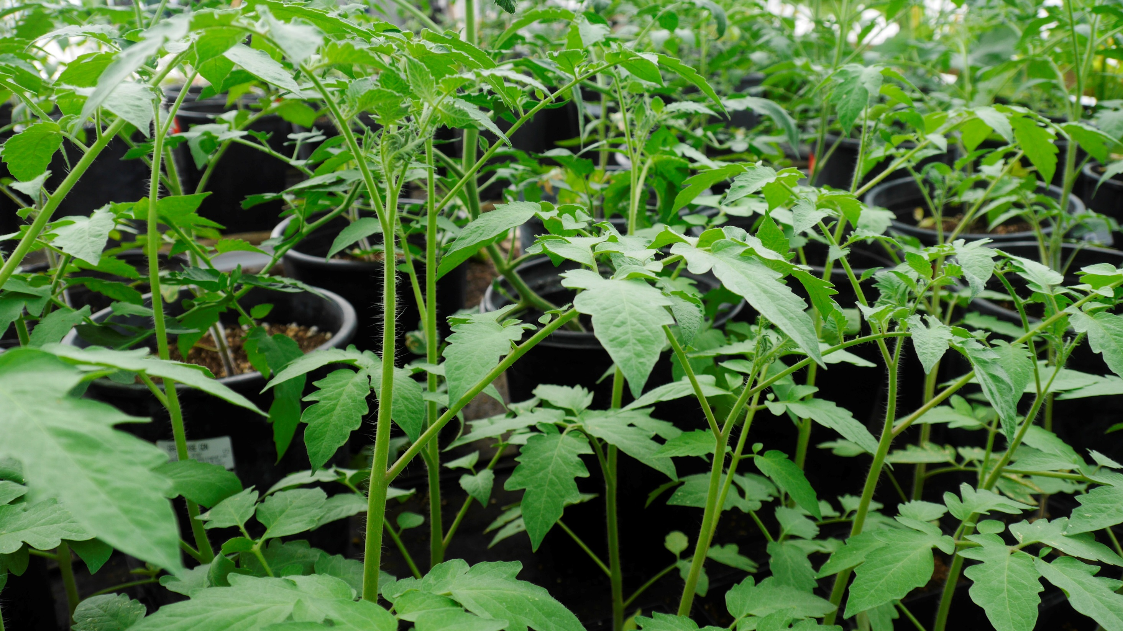
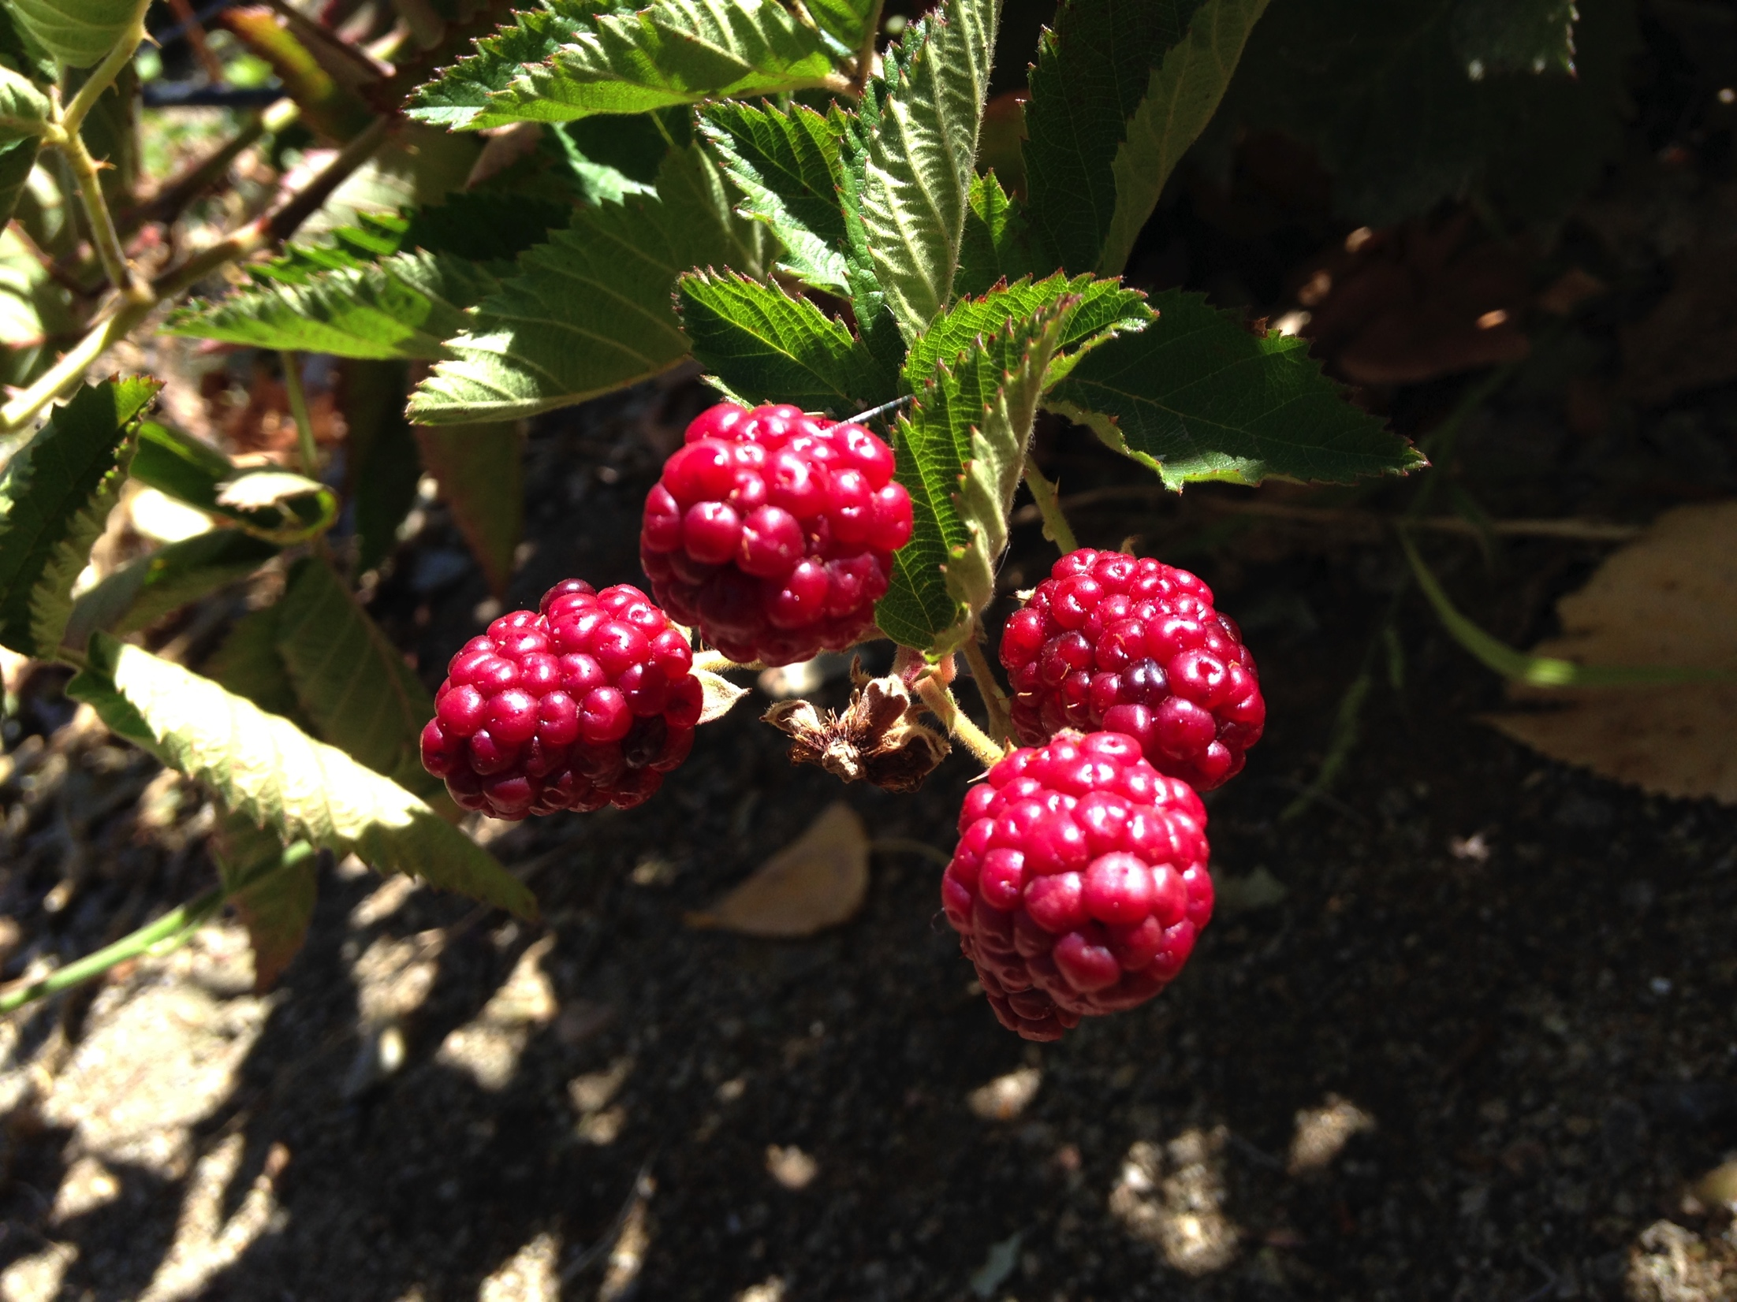
Resources for Produce Use
Nevada Food Safety Resources
Producer Certification
Craft Foods

Slide 5
School Garden Sage
Michael Ismari, Washoe County School District

Slide 6
Resource Sharing
What are you doing in your program that others might replicate?
What resources are you aware of?
Funding
Partnerships
Revenue Sources
Etc.

